Slide 1
ITP10
Multimedia Systems
angelitoicunananjr@gmail.com
aicunananjr.weebly.com

Slide 2
CHAPTER One
THE TOOLS OF MULTIMEDIA

Slide 3
What is multimedia?
transmission that combine media of communication (text and graphics and sound etc.)
Notes:
SAD: System Development Methodologies
(Techniques, Models and Tools)
Tools in SAD is that helps to create models or some other
components required in your project

Slide 4
Choosing the right tools who fits in YOU.
Notes:
*hey guys! I just removed the “mr. bean” video.

Slide 5
Choosing your right tools
CPU is the heart of a modern multimedia artist’s tools
CPU
Notes:
This is the main topic

Slide 6
Tools
Hardware, Software and You
Notes:
Hardware – this is where your software or applications will runs.
Software - this tools help your idea to be made and visible.
You – probably the most important, without the existence of the people, hardware and software are useless
The real brains of this operation

Slide 7
Hardware
What is its primary function?
Notes:
Digital Video
Computer Animation
Graphic Arts
Web Design

Slide 8
Computer Animation
3D Rendering – is the 3 dimensional computer graphics process of automatically converting 3D wireframe models into 2D images with 3D photorealistic effects.
Wireframe – skeletal 3D Model consist of Lines and Vertices.
Notes:
Animation is the state of being alive: movements
2D [Two Dimensional] – Height & Width
3D [Three Dimensional] – Height, Width and Depth
Vertices or vertex – point of intersections

Slide 9
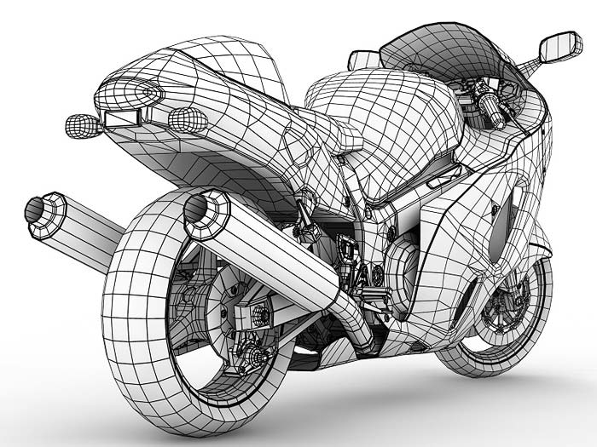
Wireframe
Notes:
Wireframe also called as Low Resolution mode

Slide 10
Computer Animation
Render farms – are group of machines whose sole purpose is to process work from animators and modellers.
- is high performance computer system. (Wikipedia)
Notes:
Render farms Consist of several machines
hooked together
working on the same problem

Slide 11
Digital Video
Unlike with 3D animation, there are no render farms where you can offload your processing. However you can get help from Video Cards that will process some of the most common effects in real time.
Common video editing software:
Final Cut Pro
iMovie
Vegas
Adobe Premiere
Avid, etc.
Notes:
Digital Video
Most of your editing will handle real-time video processing.

Slide 12
Graphic Arts
Photoshop – the most intense application you'll probably run.

Slide 13
Video Cards
Two instances:
Video Production
Gaming Related Work
Notes:
Video Cards are specialized to render your work faster

Slide 14
Sound Cards
Sometimes these must be added, especially if you want to perform high-end sound functions.
Notes:
In some instances, you can use your built-in sound cards.
Not necessarily

Slide 15
Memory
RAM (Random Access Memory)
The more you have, the better your system will operate, the more programs you'll be able to run at the same time, and the faster they will perform
Notes:
In multimedia,
Memory means Speed

Slide 16
External Storage
Your extra pocket aside from your hard drives.
USB and FireWire Connections
FireWire – aka IEEE 1394, allows extremely fast data rates, plug and play, and the ability to daisy chain peripherals.
2 Flavours of IEEE 1394:
400Mbps (original)
FireWire 800 (800Mbps) (newer)
Notes:
Look not only at the size
But look also at the Speed
FireWire- standard designed by apple
Daisy chain – connect them to each other chain

Slide 17
External Storage
USB and FireWire Connections (continued)
USB – Universal Serial Bus, sometimes used in slower devices like keyboards, mouse, scanners etc. Daisy chain ready.
3 Flavours of USB
Standard USB (12Mbps)
USB 2.0 (480Mbps)
USB 3.0 (625Mbps)
Notes:
USB 3.0 adds a new transfer mode called "SuperSpeed" (SS)
*REMEMBER
The more chain you have, the more slower you get.

Slide 18
PC vs. Mac
Notes:
Non-issue,
because a true multimedia designers will work with the combinations of these environments…
Any of two

Slide 19
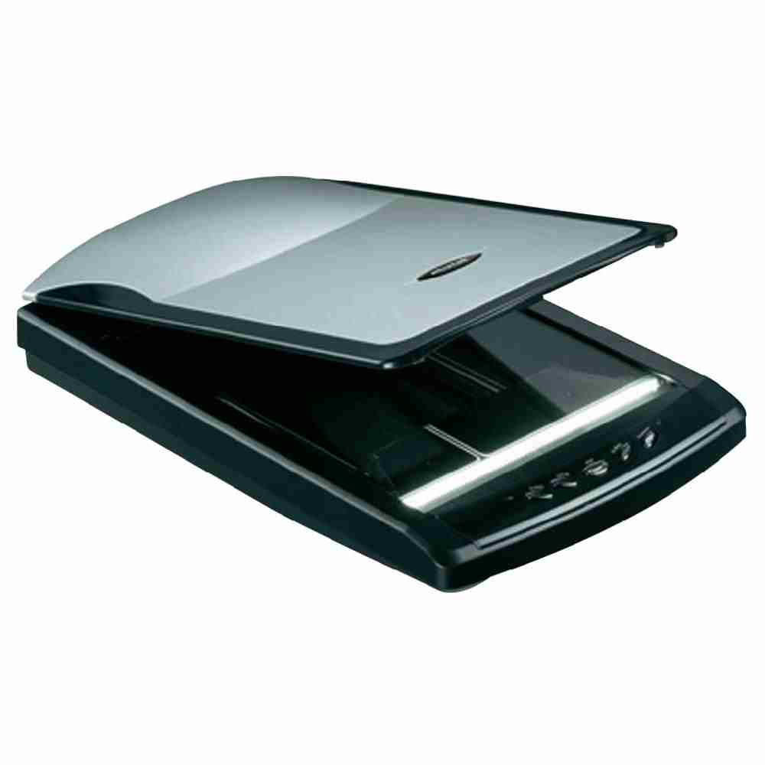
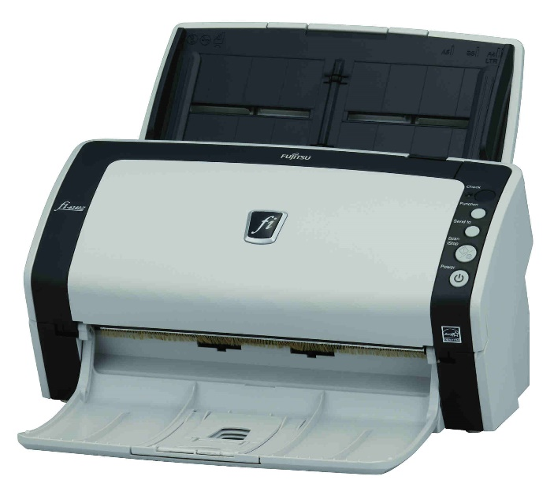
Scanner
Flatbed, Drum & Sheetfed Scanner
Notes:
Scanner: A digital representation of an image for data input to a computer
Flatbed is the most common scanners today. You place the media facing down on a glass plate… like photocopying
Drum used in high – end publishing industry and very costly.. They called drum scanner because of the glass cylinder that the image is mounted on for scanning
Sheetfed is a really variation of the flatbed but, in this scanner, the paper moves and the scanning elements does not.

Slide 20
Scanner (continued)
What to look in a scanner
Resolution (types)
True Resolution (Hardware Resolution)
Interpolated Resolution
Bit-Depth – refers to the number of colours the scanner can recognized
Other Features like OCR (Optical character Reading)
Notes:
OCR allows you to convert image to data, so that computer can use to something…

Slide 21
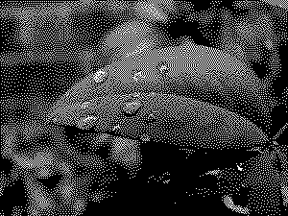
Notes:
1 bit – 2 colors

Slide 22
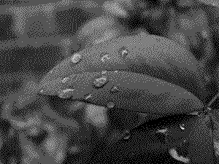
Notes:
2 bits – 4 colors

Slide 23
Notes:
4 bits – 16 colors

Slide 24
Notes:
8 bits – 256 colors

Slide 25
Notes:
24 bits - 16,777,216 colors, "truecolor"

Slide 26
Digital Cameras
Optical vs. Digital Zoom p.21
Macro
LCD Display
Manual Focus
Storage
Notes:
Realm means kingdom, environment
Digital camera Used to capture images from the real world and transfer them to the computer realm
Optical zoom – it has to do with the type of lenses that came up with your camera
Digital zoom – this is the point that your lenses take out of the capability of zoom
Macro – is the ability of your camera lens to capture small tiny details
LCD display – allowing you to preview your photos after taking them (the bigger the LCD, they can be significant drain you battery)
Manual Focus – allows you to have manual control over focusing your camera
Storage – Internal and external storage must be consider

Slide 27
Digital Cameras (continued)
Resolution
Rechargeable Batteries
Tripod
Lightning
Notes:
Resolution – resolution in digital cameras are measured in pixels. The higher resolution, the fewer pictures you will store but the more quality you get
JPEG (joint photographic experts group) some quality lost during compression (small)
TIFF (Tagged image file format) or a raw format where no quality is lost while taking a photos (big)
Tripod will help keep the camera steady
Lightning for additional light
All Lightning and Photography is in chapter 4

Slide 28
Digital Video
CCD (1 or 3)
Optical vs. Digital Zoom
Image Stabilization
LCD Monitor
Notes:
A charge-coupled device (CCD) is a device for the movement of electrical charge, usually from within the device to an area where the charge can be manipulated, for example conversion into a digital value. This is achieved by "shifting" the signals between stages within the device one at a time.
CCD manufacture with a special process that allows them to capture high quality, low-niose-images
Optical vs. Digital Zoom – much zoomed, much shaky
Stabilization – light shaking to take place during filming.
LCD –

Slide 29
Digital Video (continued)
Microphone
Tripod
I/O
Lightning
Notes:
Microphones on video cameras are adequate (acceptable in quality) for simple projects, but
For a better quality of audio, you must use external device for a high quality of sounds (e.g. Audio Recorder)
Tripod
I/O for external audio and display
Lightning in video is more crucial than photography because most in photographic, you can adjust aperture or exposure settings to get a good quality of picture

Slide 30
Software
A computer would be pretty useless without software, and there is an amazing array of software a digital designer must be familiar with.

Slide 31
Photo Editing
Adobe Photoshop

Slide 32
Illustration
Adobe Illustrator

Slide 33
Audio
p.28

Slide 34
Players
WinAmp, RealPlayer, QuickTime, Windows Media Player, iTunes, VLC

Slide 35
Sound Recorders and Rippers
iTunes is an example of a ripper sound program
Notes:
CDA files are not audio files, because they do not contain sampled sound at all. CDA files are just a way that Windows uses to let you access an Audio CD index. This is why if you copy a .CDA file to our hard drive and try to play it with an audio player, nothing happens.

Slide 36
Sound Editor
Adobe Audition

Slide 37
Sound Converters
Converts sound from one format to another: mp3 to WAV etc.
Notes:
WAV to MP3 = low-end file

Slide 38
MIDI Software
Videoke players
Notes:
Musical Instrument Digital Interface

Slide 39
Loop-based Music Editor & Recording Studios
Notes:
Combines audio from any source to create multitrack recordings, add special effects and import/exports many formats.

Slide 40
3D Modelling, Rendering, Animation
p.33

Slide 41
Authoring CD-ROM, Internet, Video Development
p.35

Slide 42
YOU
Swiss army knife of creative types.
Notes:
p.36

Slide 43
YOU
The Computer is Just One of Your Tools
Love to Learn
Learn to Enjoy Challenges
Networking
Be Professional
Notes:
p.36

Slide 44
Thank YOU!
End of slides…
Notes:
p.36

