Slide 1
ITP05
Network Management
angelitoicunananjr@gmail.com
aicunananjr.weebly.com

Slide 2
700BC
#throwback
Notes:
The Greeks used homing pigeons to establish rudimentary (basic principle) information network
homing pigeons find its way home over extremely long distances.

Slide 3
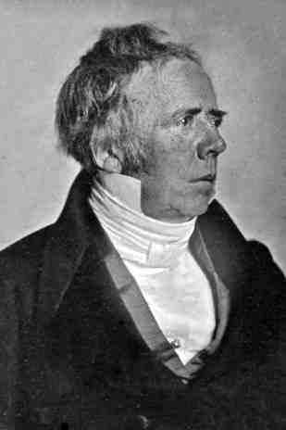
1819
Hans Oersted
Notes:
Wire that carrying electric current could deflect (change direction) a magnetized needle
Opening the way for wire-based telegraph networks.

Slide 4
What is a network?
Word-of-mouth communication, cell phone or telephone, & computer
Notes:
Basic network - Word-of-mouth communication

Slide 5
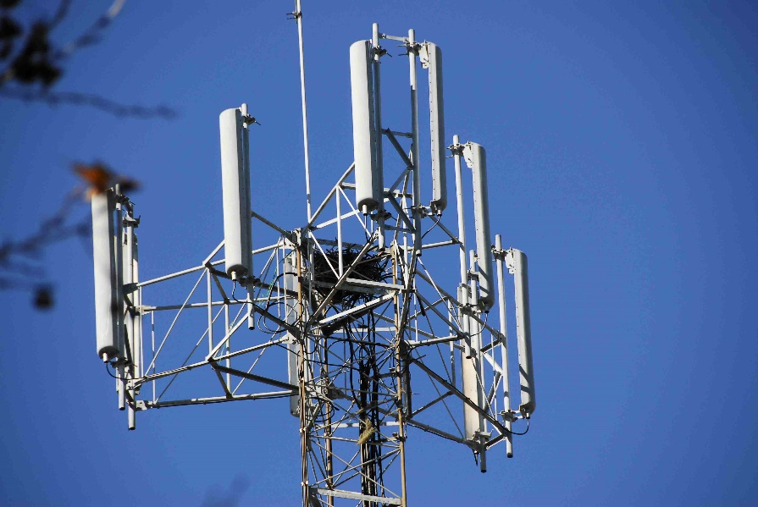
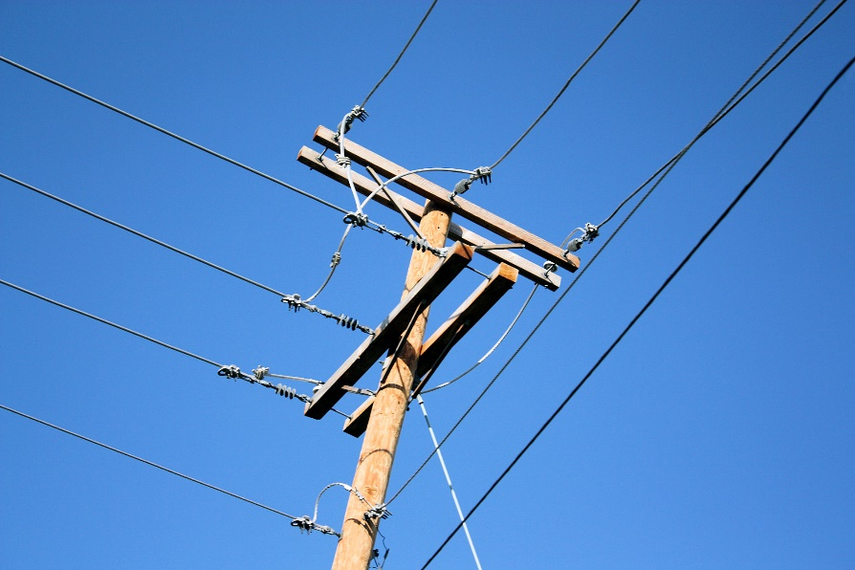
Cell phone or Telephone
As network
Notes:
Cellphone – radio waves
Telephone – connected to miles of cables
All connected to world by vast network of communications equipment

Slide 6
What is a Computer network?
A system of computers, print devices, network devices and computer software linked by radio waves or communication cable
Notes:
Data over Copper wire before
Data, voice, video communications over wire, fiber-optics media,
radio waves, infrared waves, and microwaves today

Slide 7
Types of Network
PAN, LAN, CAN, MAN, WAN

Slide 8
PAN
Personal Area Network - very small distances and lowest in complexity
Notes:
Roughly about 10 meters or 33 feet

Slide 9
LAN
Local Area Network - Interconnects computers, printers, other equipment that share hardware and software resources in close physical proximity

Slide 10
MAN
Metropolitan Area Network - Spans a greater distance than a LAN. Links same organization or to several different organizations
Notes:
Up to 48 kilometers (about 30 miles)
Links multiple LANs within city or metropolitan region
(Typically uses fiber-optic/wireless connections)

Slide 11
CAN
Campus Area Network – Similar to MAN, but the difference is that all of the LANs and the buildings housing the LANs are owned by one Organization.

Slide 12
WAN
Wide Area Network – Composed of two or more LANs, MANs, or CANs
Notes:
Connected across a distance greater than 48 km (30 miles)

Slide 13
Basic Networking Terms

Slide 14
Node
- AKA (station): any device connected to a network
3 nodes important to users:
Workstations
Hosts
Servers
Notes:
Personal computer, server, mainframe, supercomputer,
printer, fax, DVD/CD-ROM, disk array, network device

Slide 15
3 nodes important to users:
Workstations – has CPU, OS, Applications like MS Office, & may fulfil roles as client (workstation accessing data or software on another computer) and host
Hosts - the computer accessed for data or software by a client workstation
Servers - Powerful computers offering multiuser access
Notes:
1. Personal computer, server, mainframe, supercomputer,
printer, fax, DVD/CD-ROM, disk array, network device
2.
3. Holds software applications and data files
Users who visit a website are accessing a server

Slide 16
3 nodes important to users:
Workstations – has CPU, OS, Applications like MS Office, & may fulfil roles as client (workstation accessing data or software on another computer) and host
Hosts - the computer accessed for data or software by a client workstation
Servers - Powerful computers offering multiuser access
Notes:
1. Personal computer, server, mainframe, supercomputer,
printer, fax, DVD/CD-ROM, disk array, network device
2.
3. Holds software applications and data files
Users who visit a website are accessing a server

Slide 17
3 nodes important to users:
Workstations – has CPU, OS, Applications like MS Office, & may fulfil roles as client (workstation accessing data or software on another computer) and host
Hosts - the computer accessed for data or software by a client workstation
Servers - Powerful computers offering multiuser access
Notes:
1. Personal computer, server, mainframe, supercomputer,
printer, fax, DVD/CD-ROM, disk array, network device
2.
3. Holds software applications and data files
Users who visit a website are accessing a server

Slide 18
Using network in a Home…
Notes:
Sharing files and printers
Accessing the Internet and entertainment resources
Connecting home resources (Computers, entertainment devices, appliances)
ICS – Internet connection Sharing: network and sharing center> Change adapter>properties of specific network.

Slide 19
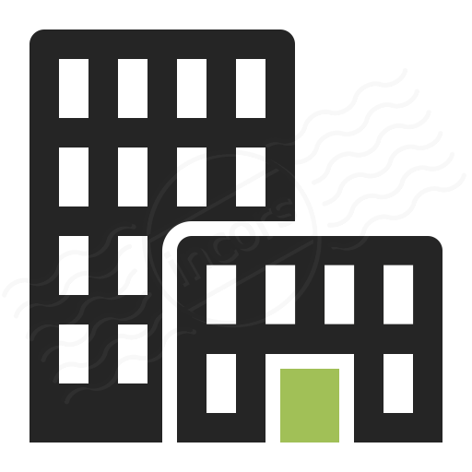
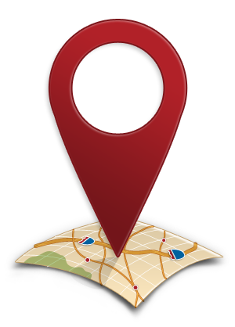
Using network in an Office…

Slide 20
Business Strategy
Notes:
Using internet connections (simple order system)

Slide 21
4 Network Properties
Communication Medium
Protocol
Topology
Network type (private vs. public)
Notes:
Changing of a one medium to another. Fiber>waves… etc.
How each unit is transmitted and how it is being interpret (chapter 2)
The design layout: 2 components
Physical Layout
Logical Path
From private (local) to public (internet): the boundaries starts at the point when local meets public

Slide 22
Network Topologies
Is a physical layout combined with logical path.
Decentralized network layout - Cable running between each station on network
Centralized network layout - Each station physically connected to central device
Notes:
1. Physical layout – which the cabling is laid in the building, office etc. is also often called cable plant

Slide 23
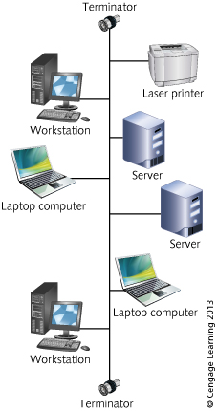
1. Bus topology
Has starting point and an end
Point (terminator).
Like a chain
Notes:
When transmitting a packet across a bus:
It is detected by all nodes on the segment
Given time limit to reach destination or it is considered late

Slide 24
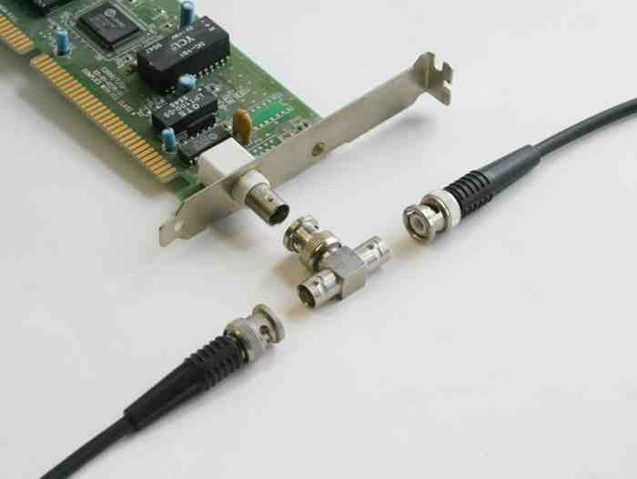
Notes:
Example of connectors in bus topology and
Tp/ft-10 BUSterminator

Slide 25
IEEE - Institute of Electrical and Electronics Engineers
International organization of scientist, engineers, technicians, and educators
Notes:
Develops standards for network cabling, transmission
Advantages of bus design
Requires less cable than other topologies
Easy to extend bus with a workstation
Disadvantages of bus topology
High management costs
Single defective node can take down entire network
Can become quickly congested with network traffic

Slide 26
2. Ring topology
Advantages to ring topology
Easier to manage than bus
Suited to transmitting signals over long distances
Disadvantages to ring topology
More expensive to implement than bus
Has become outdated so there are fewer equipment options
Notes:
Continuous data path with no beginning or ending point
Before: one loop (cycle) then back to source
Now: Two loops for redundant data (for assuring the transfer of data) > opposite direction

Slide 27
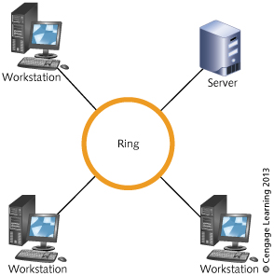
Notes:
Before: one loop (cycle) then back to source
Now: Two loops for redundant data (for assuring the transfer of data) > opposite direction

Slide 28
3. Star topology
Advantages
Start-up costs are much lower than other topologies
Easier to manage, defective nodes quickly isolated
Easier to expand by connecting nodes or networks
Offers better equipment and high-speed options
Cabling and connectors are less expensive
Disadvantages
Failure of central device may cause network failure
Requires more cable than bus
Notes:
The oldest communication design method
multiple nodes attached to central device (hub, switch, router)

Slide 29
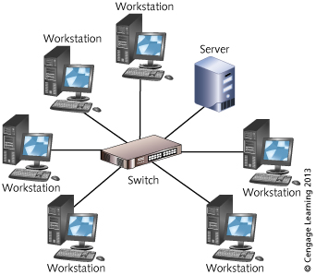

Slide 30
4. Star-Bus Hybrid topology
Advantages of star-bus topology
No exposed terminators
Easily connect switches/routers to expand network
Connection between central devices is a backbone
Backbone enables high-speed communication
Central devices have built-in intelligence to help detect problems
Many equipment and high-speed options available
Notes:
Star-Wired Bus Topology
Each radiating finger is separate logical bus segment,
Each segment terminated at both ends

Slide 31
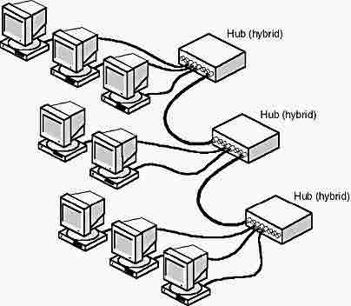

Slide 32
5. Star-Ring Hybrid topology
Hub or access unit acts as linking device
Transmission of signal uses logical communication of ring
No need for built-in terminators

Slide 33
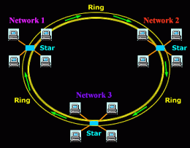

Slide 34
6. Mesh topology
Every node is connected to every other node in network
Provides fault tolerance
Expensive to implement
Notes:
Fault tolerance: built-in protection against failure
If link breaks, nodes can still communicate

Slide 35
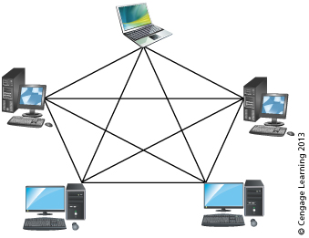

Slide 36
6. Tree topology
Advantage of the tree topology:
Can segregate network traffic so that communications in one limb of the tree can be isolated from other limbs
Important for highly secure networks
Disadvantage of the tree topology:
On cabled networks, may require more cable
If main trunk is down, connected limbs can not communicate with one another
Notes:
expanded star
Consists of a trunk (or bus) with limbs and branches (star)

Slide 37
Thank YOU!
End of slides…
Notes:
p.36

